Slide 1
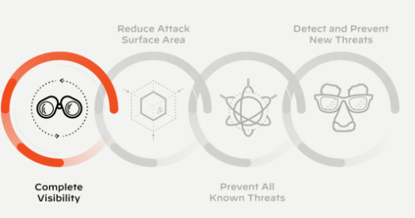
Palo Alto Networks Portfolio Overview Palo Alto Networks Portfolio Overview

Slide 2
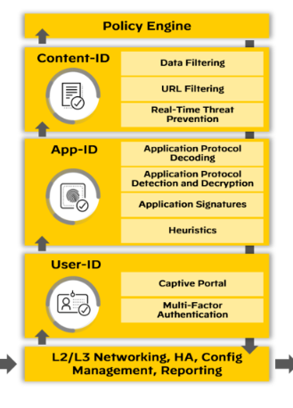
Next-Generation Firewall Architecture Single pass parallel processing

Slide 3

Offering

Slide 4
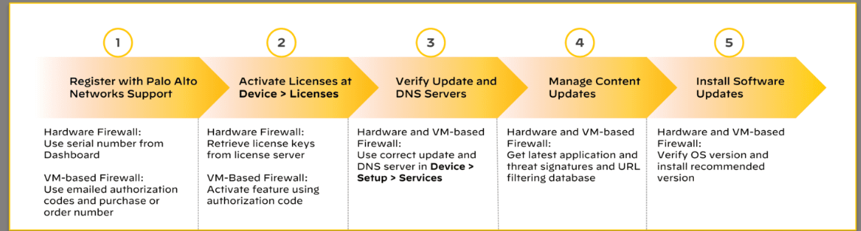
Activation of FW

Slide 5
Subscription
Wildfire
Global Protect
Auto Focus
URL filtering
Virtual Systems
Cortex
Threat Prevention
DNS Security
SD-WAN

Slide 6
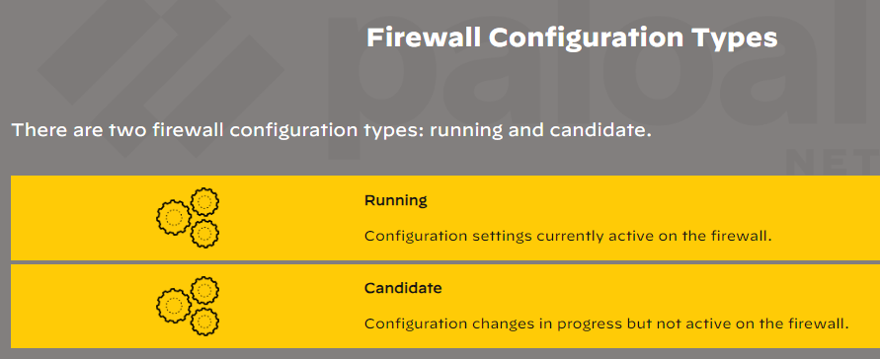
Configuration Management

Slide 7
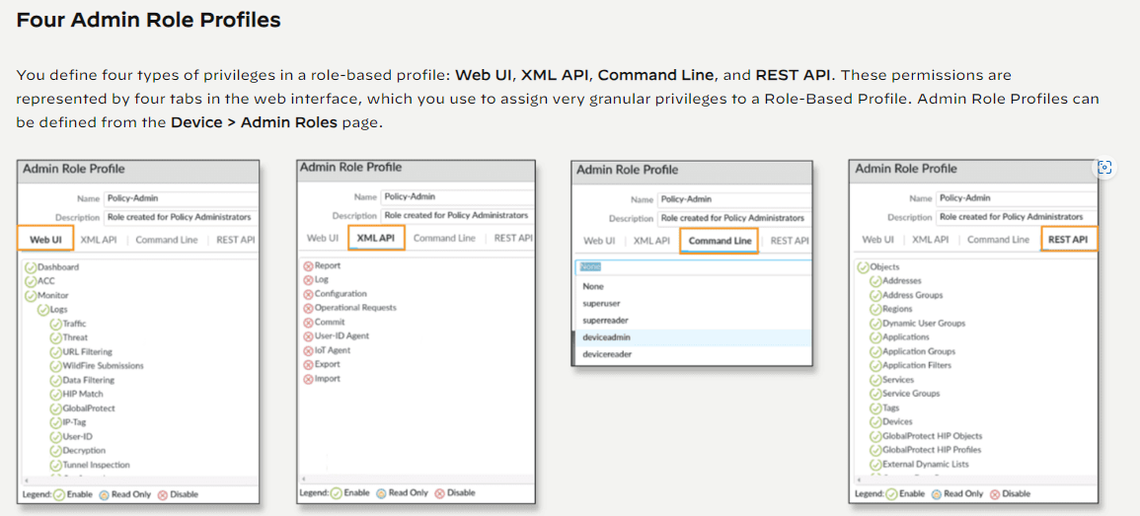

Slide 8
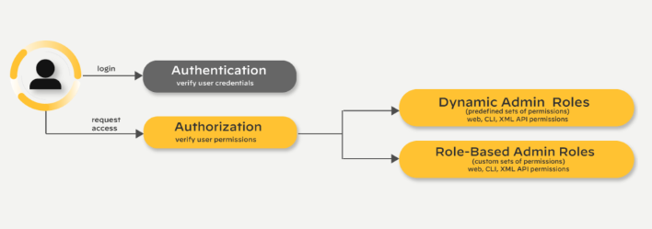

Slide 9
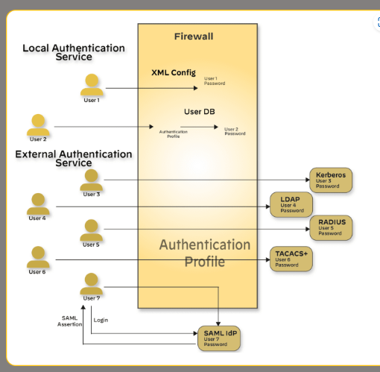
Authentication Profiles

Slide 10
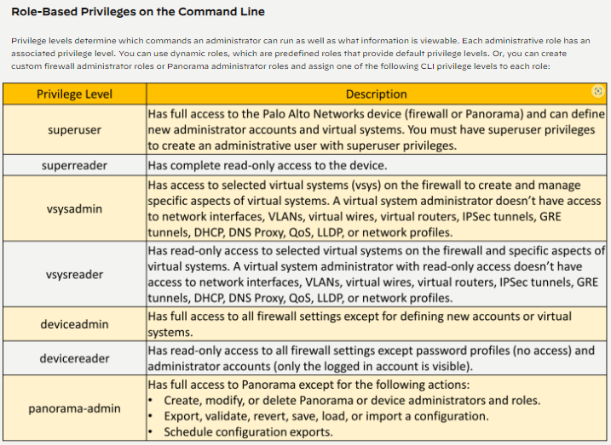

Slide 11
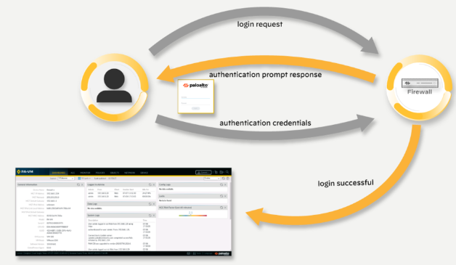
Password Authentication(Interective)

Slide 12
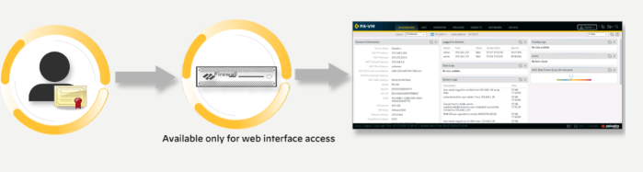
Certificate-Based Authentication (Non-Interactive)

Slide 13
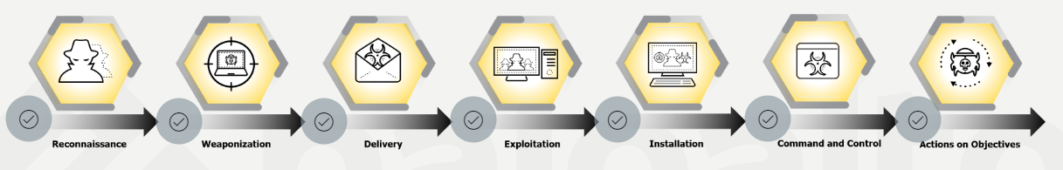
Zone Security, Security and NAT Policies Cyber Attack Lifecycle

Slide 14
Interface Types
TAP
Virtual
Layer2
Layer3

Slide 15
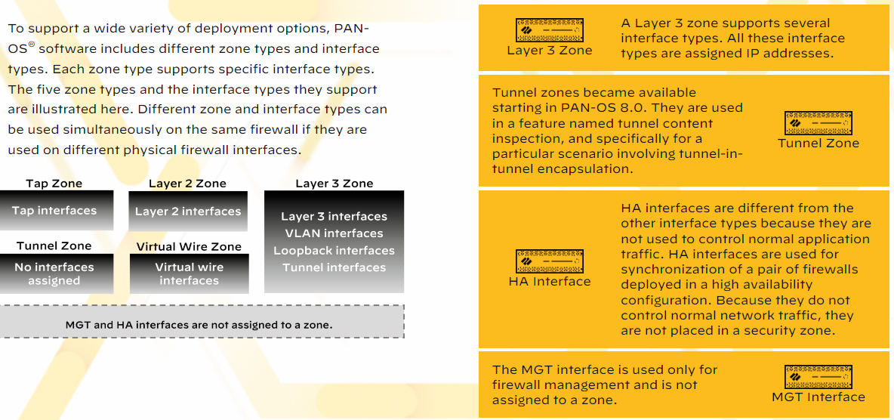

Slide 16
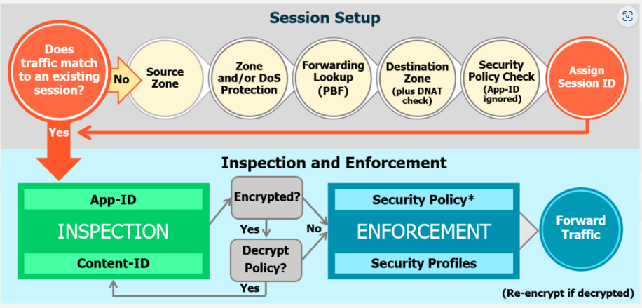
Security and NAT Policy

Slide 17
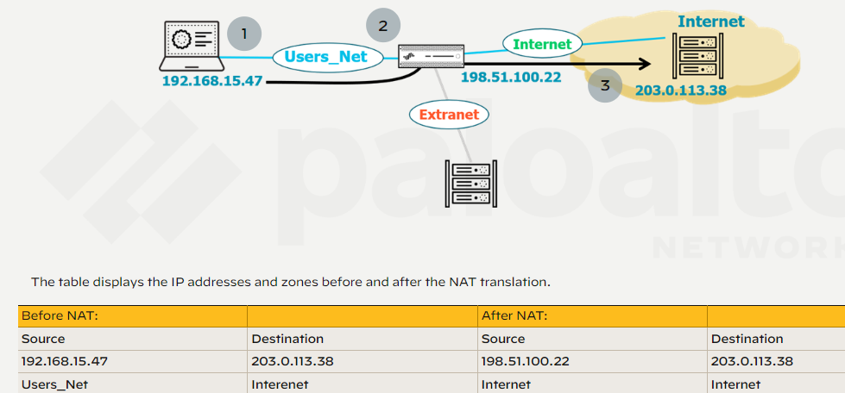
SRC NAT

Slide 18
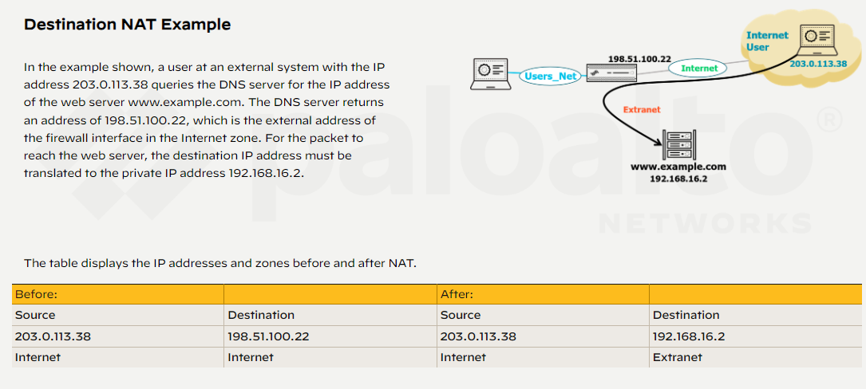
DST NAT

Slide 19
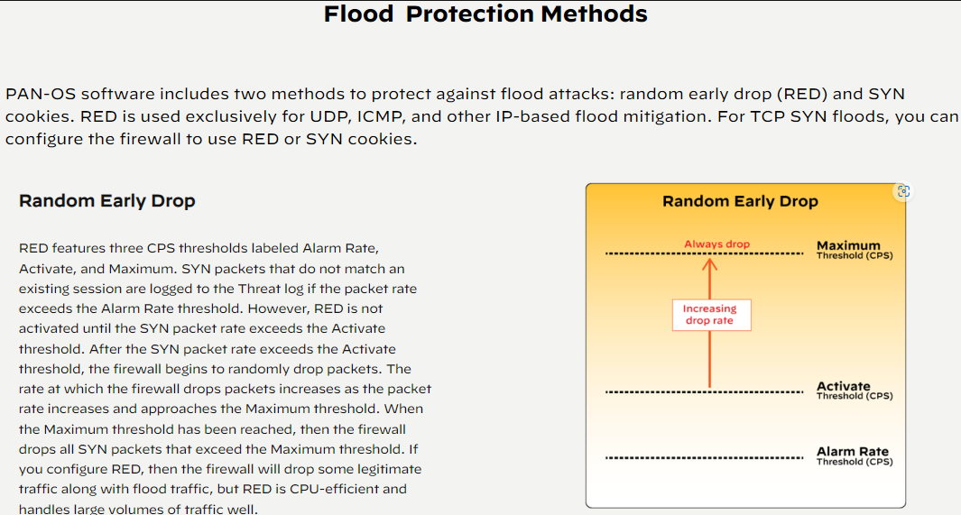

Slide 20
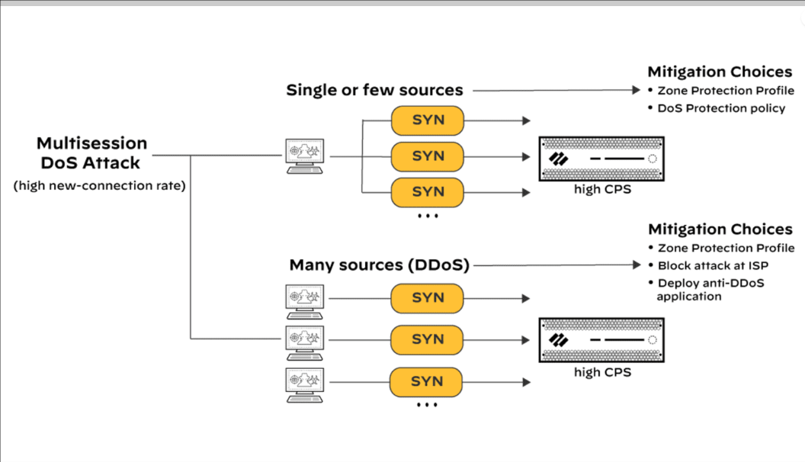
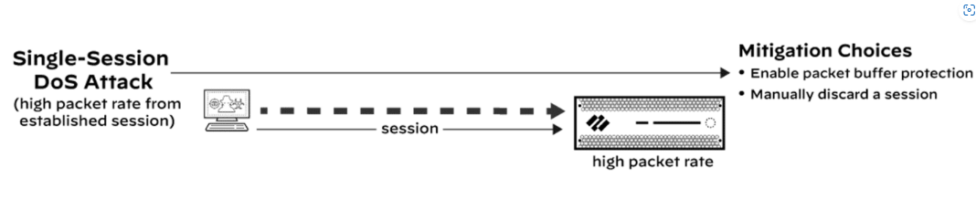
Mitigate DOS Attack

Slide 21
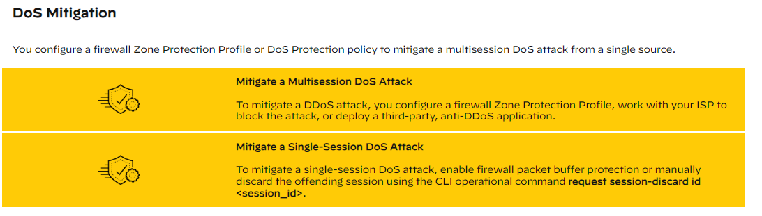

Slide 22
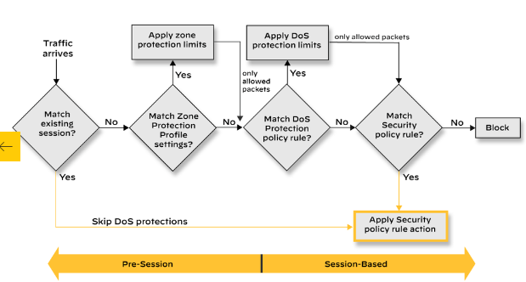
DoS Protections and Security Policy Interaction

Slide 23
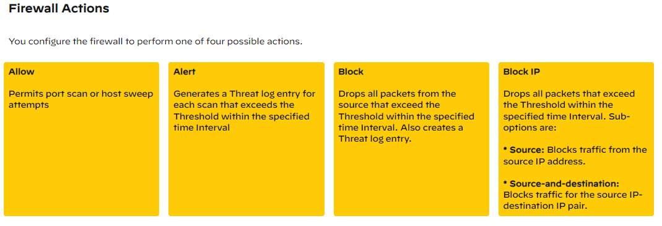

Slide 24
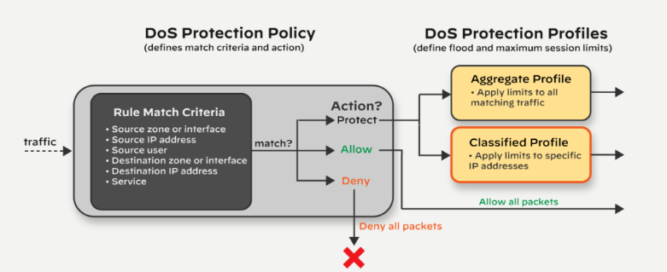
DoS Protection Policies and Profiles

Slide 25
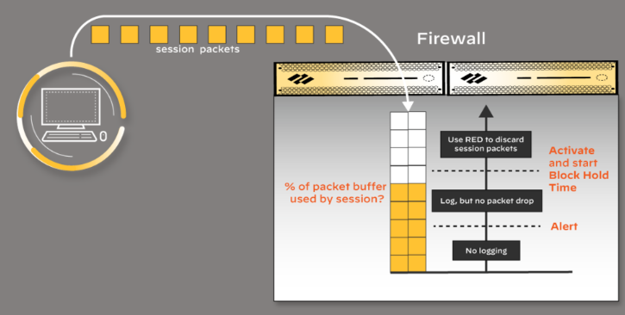
Packet Buffer Protection: Percent of Buffer Used

Slide 26
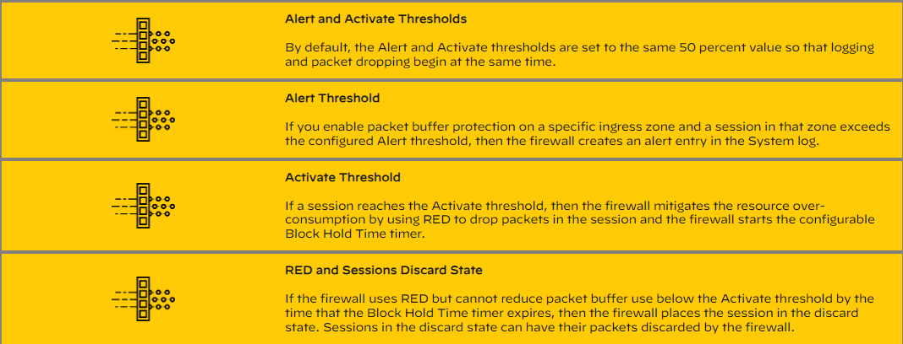

Slide 27
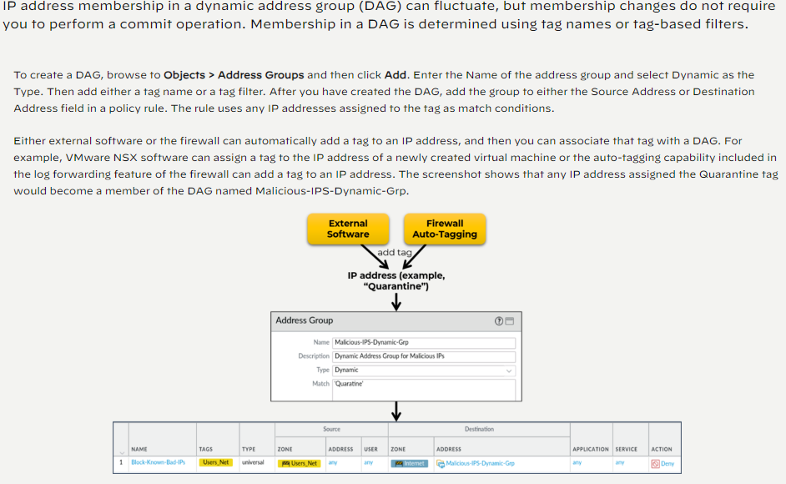
Create a Dynamic Address Group

Slide 28
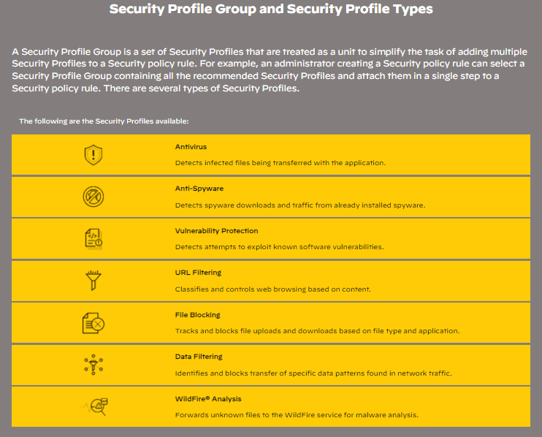

Slide 29
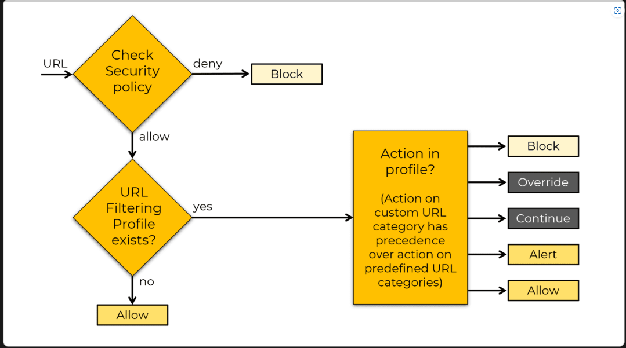
URL Filtering Action Precedence

Slide 30
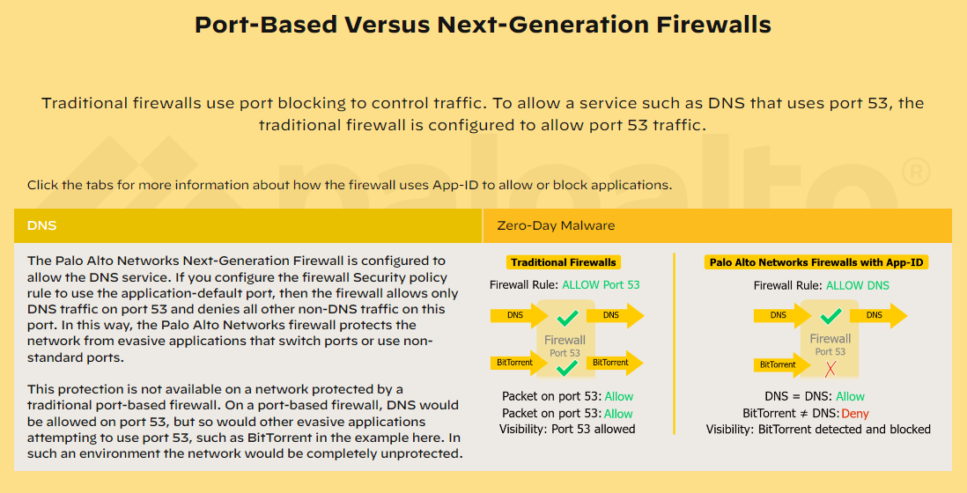

Slide 31
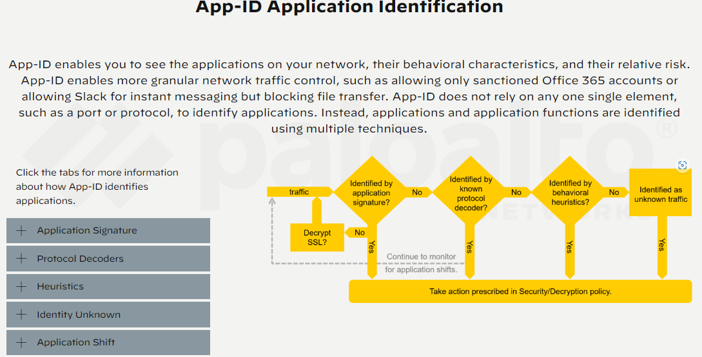

Slide 32
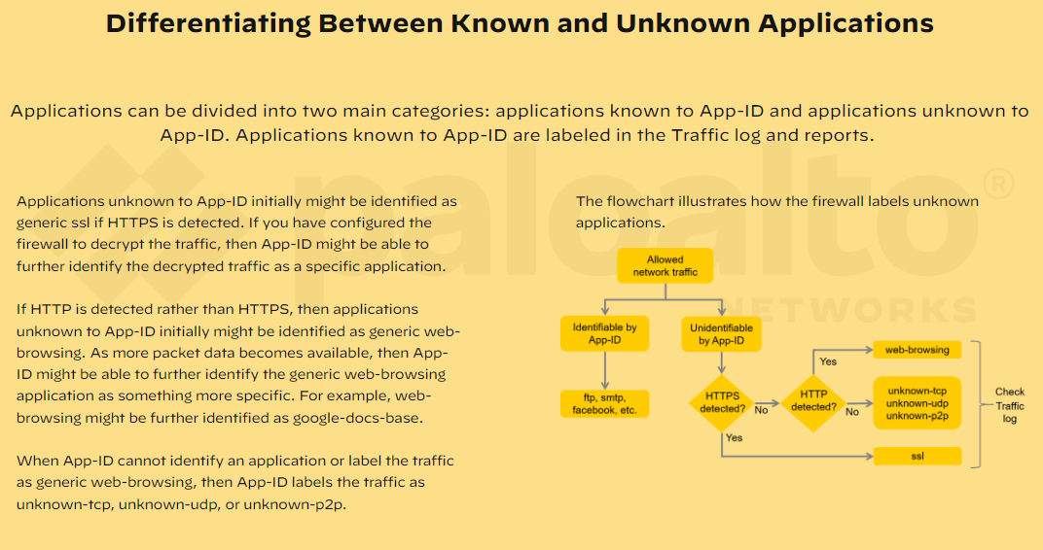

Slide 33
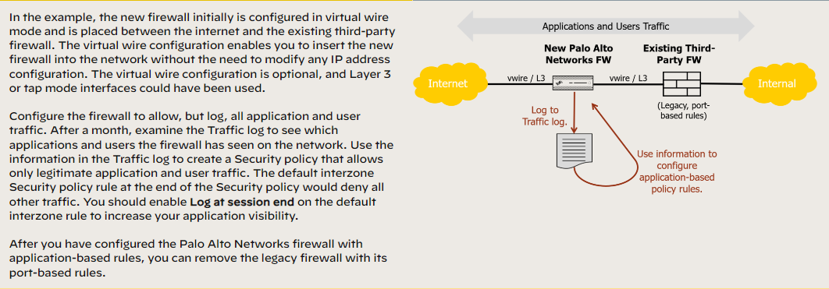
Moving to Application-Based Policies Greenfiled- Virtual Wire mode

Slide 34
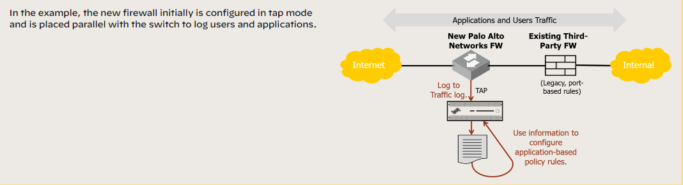
Greenfiled – Tap Mode

Slide 35
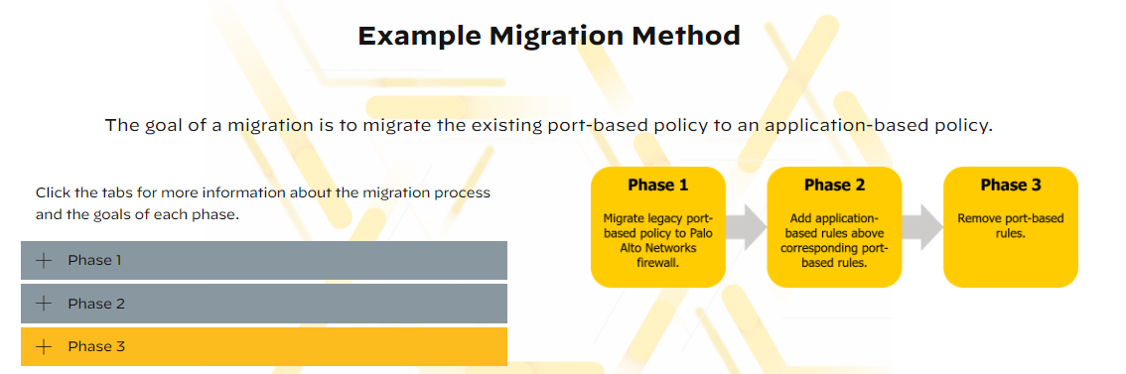

Slide 36
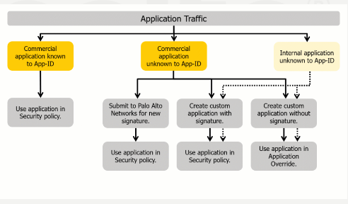
Common Methods to Control Application Traffic

Slide 37
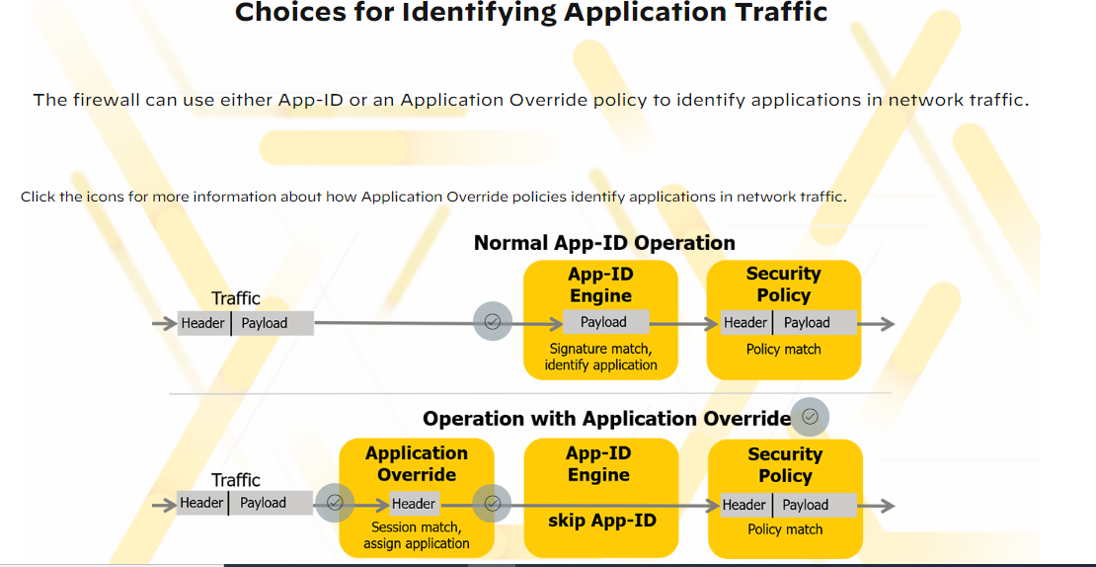

Slide 38
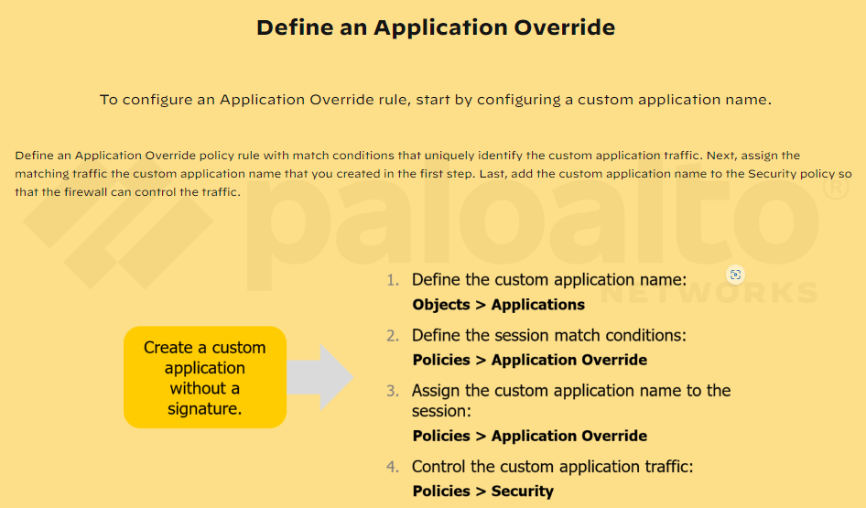

Slide 39
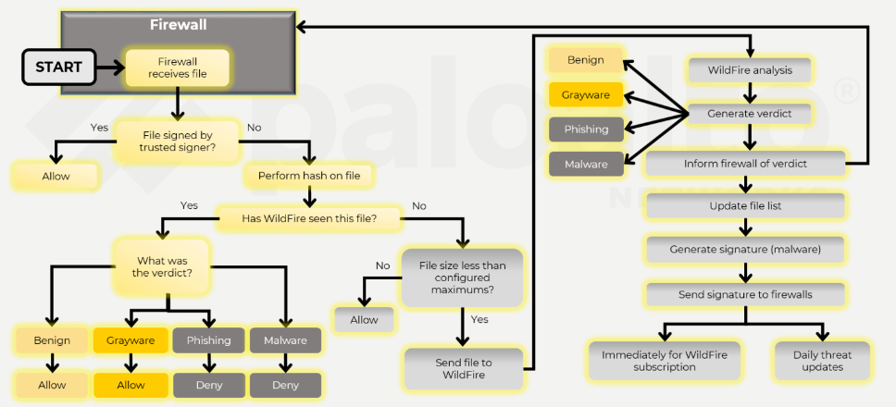
WildFire Operation Overview

Slide 40
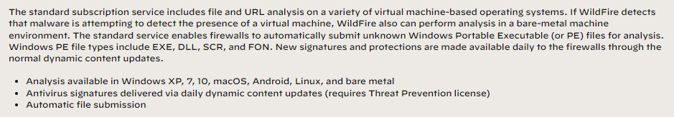
Standard Wildfire Functionality

Slide 41
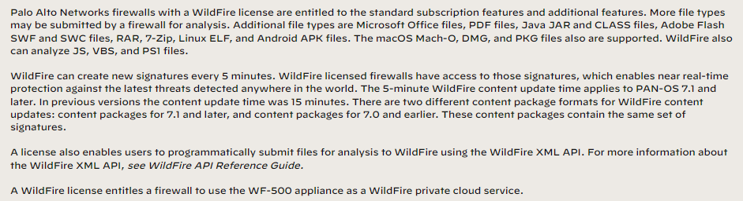
Licenced WildFire Funtionality

Slide 42
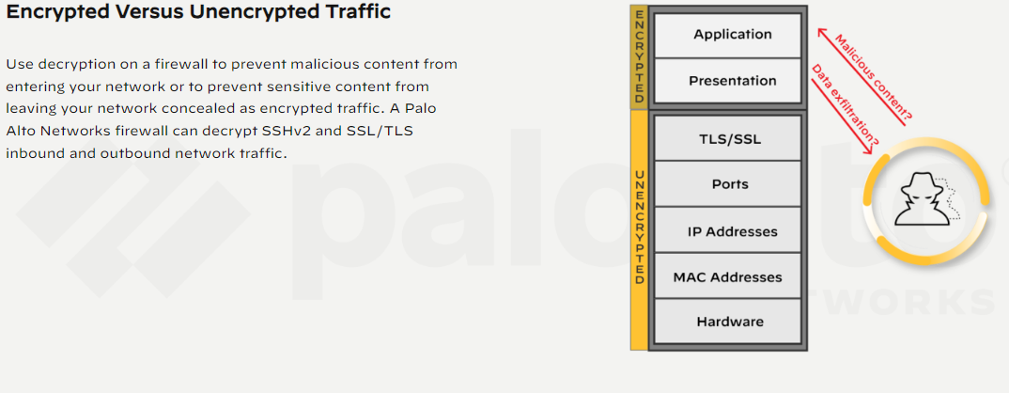

Slide 43
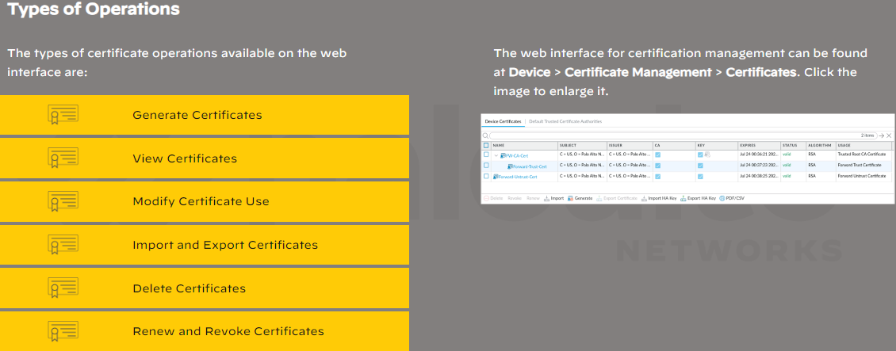
Certificate Management in the Web Interface

Slide 44
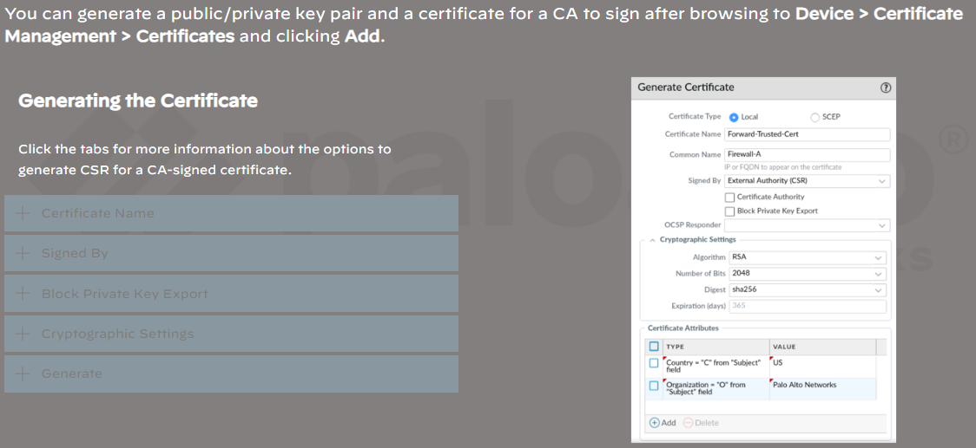
Generate a CSR for the CA-Signed Certificate

Slide 45
SSL Forward Proxy
The firewall uses SSL Forward Proxy to decrypt and inspect SSL traffic when you do not have access to private key of the SSL server. Before you configure SSL Forward Proxy, you must deploy the certificates that are used by SSL to confirm the identity of an endpoint. The firewall and SSL server must share a common CA for the firewall to validate the identity of the server. The SSL client and the firewall must have access to a common CA for the client to validate the identity of the firewall.

Slide 46
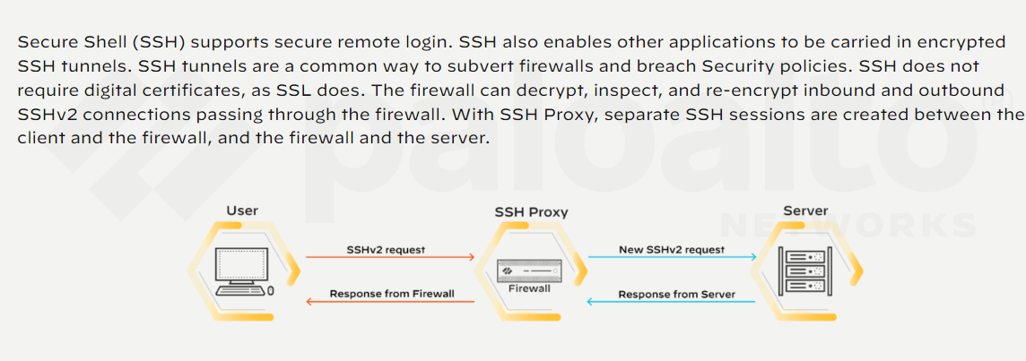
SSH Decryption

Slide 47
